Slide 1
COMP 430
Lab 4 – LCD displays

Slide 2
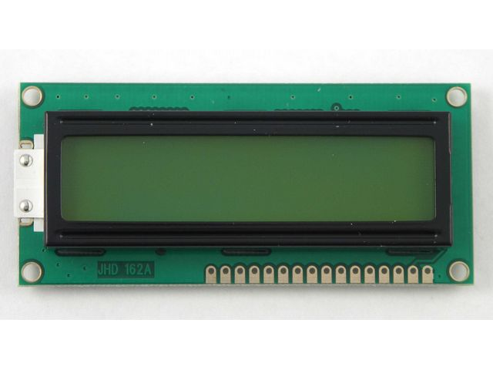

Slide 3
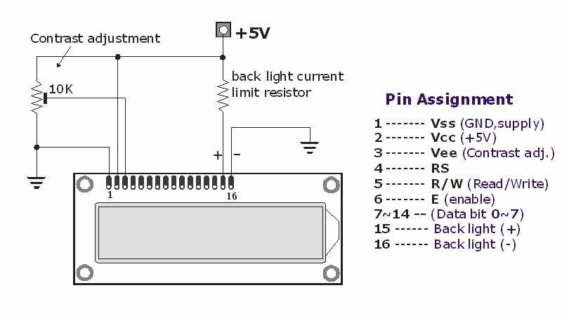

Slide 4
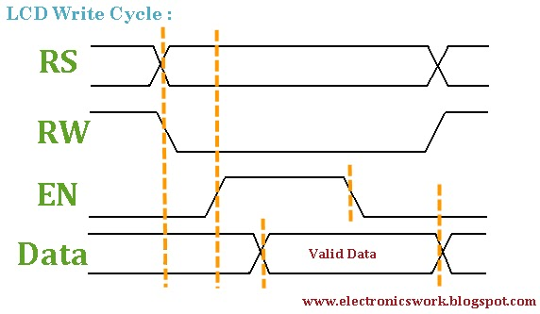

Slide 5
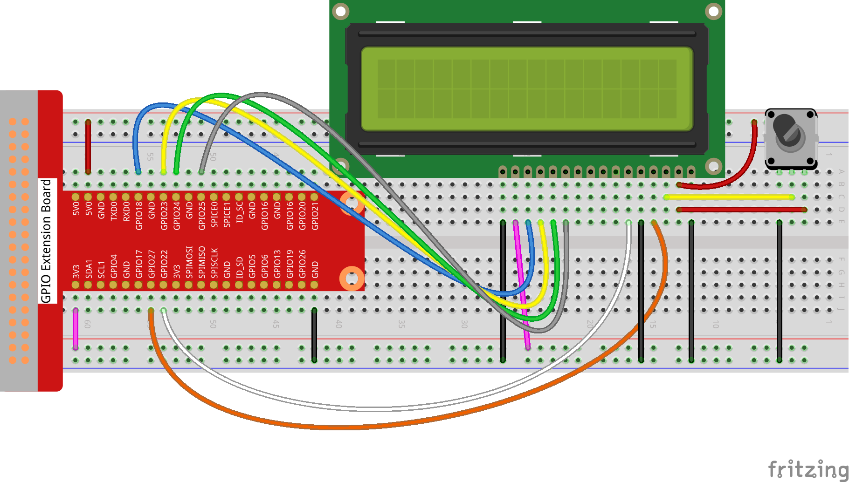

Slide 6
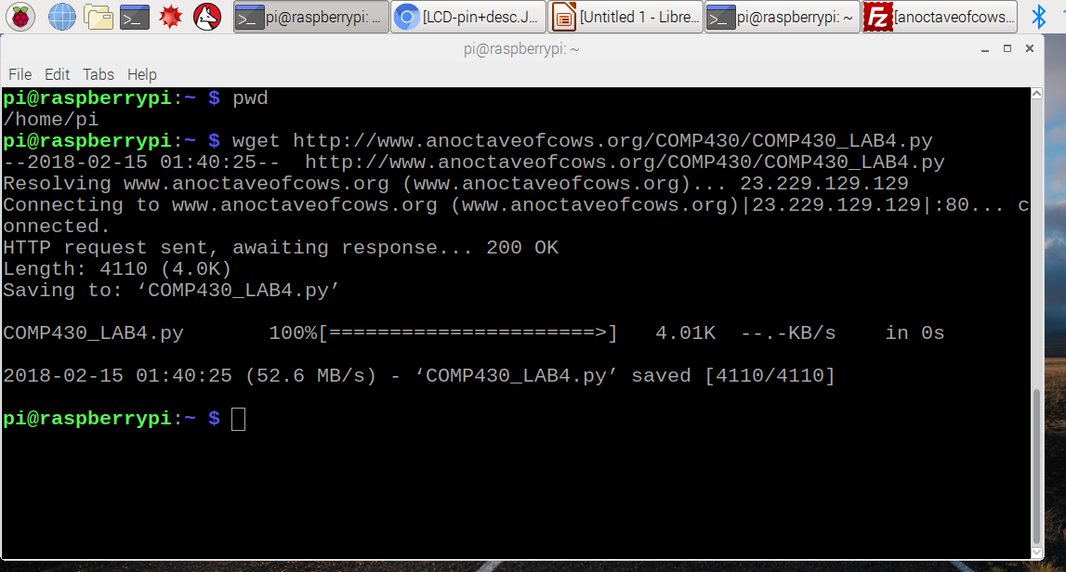

Slide 7
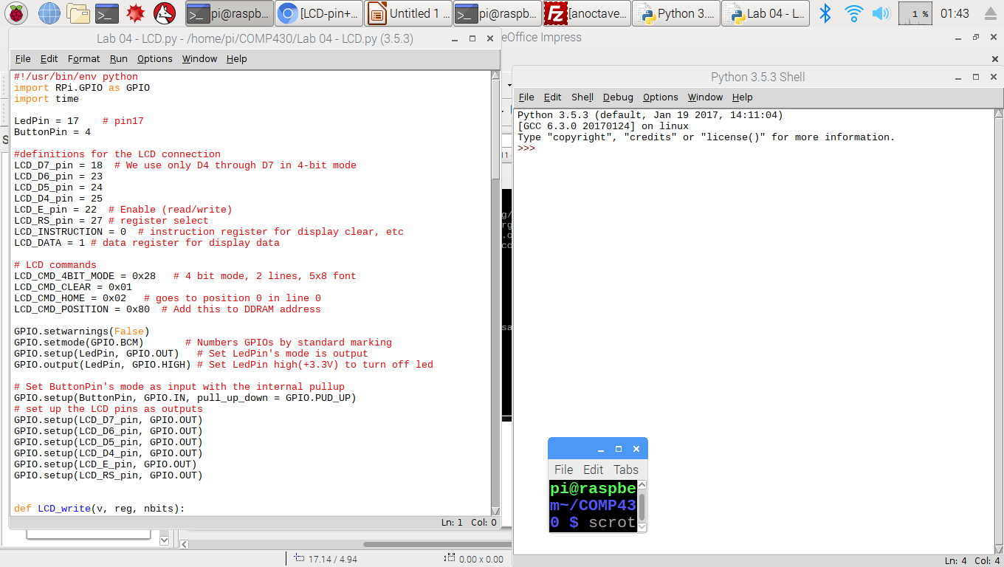

Slide 8
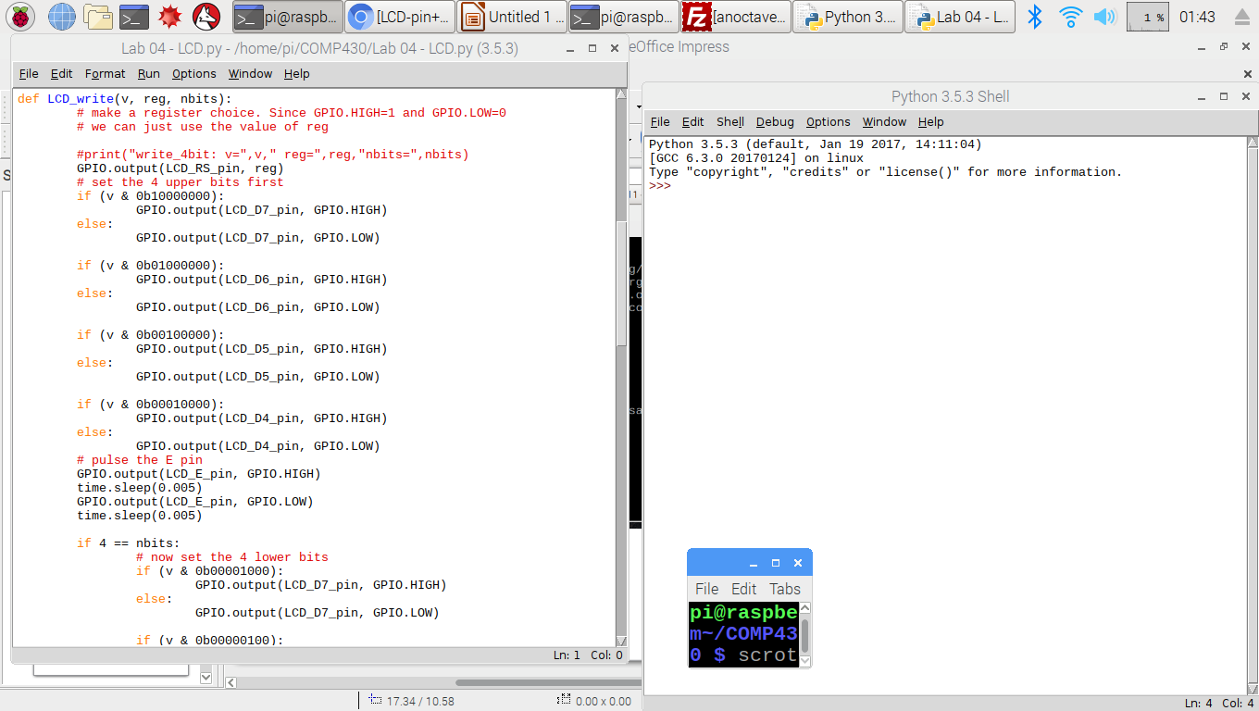

Slide 9
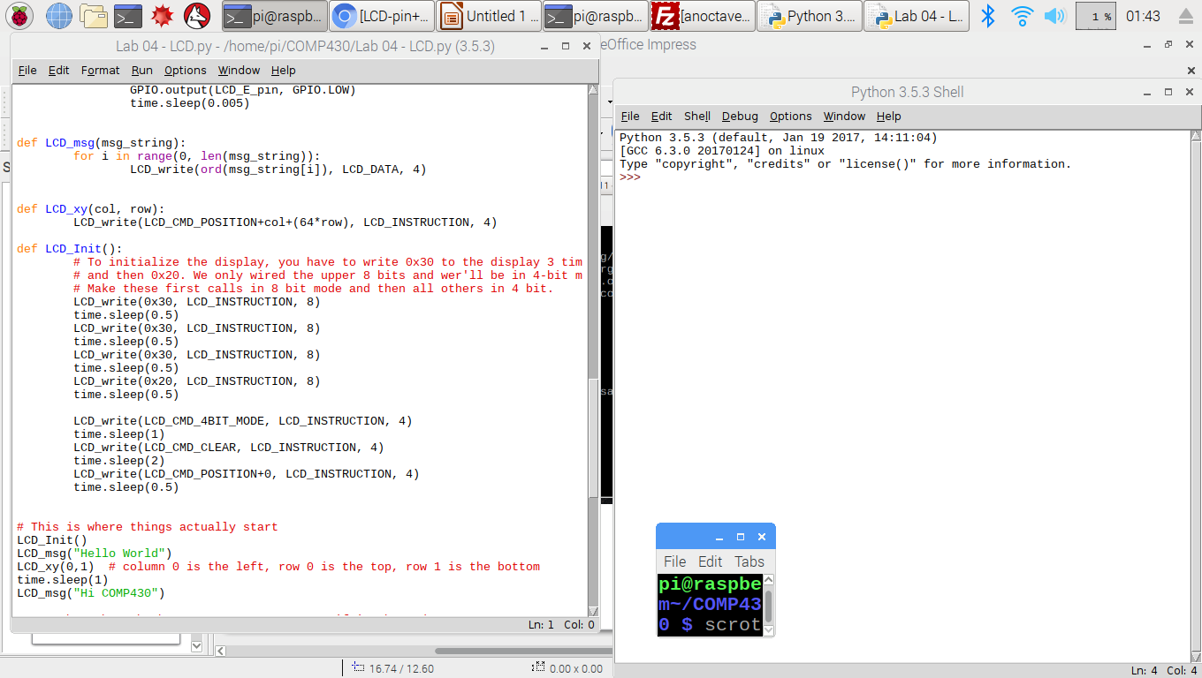

Slide 10
Write a program that uses the display in some fun way.
1) An air hockey game where an ‘X’ (puck) bounces back and forth and you press the button to return the puck?
2) A stopwatch?
3) Use an LED and the button together?

Slide 11


Slide 12
